Slide 1
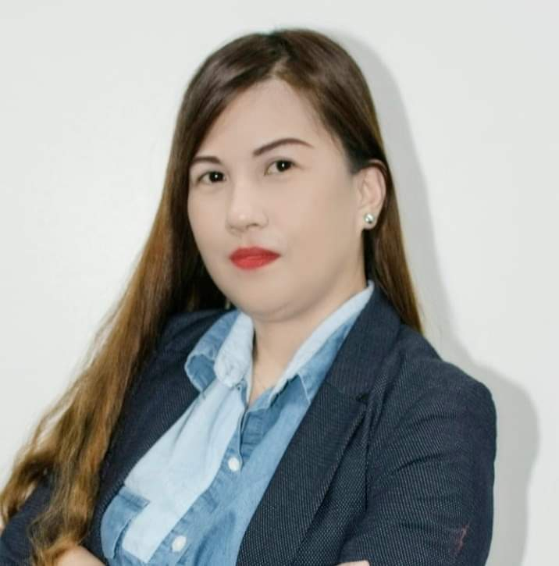
Talent Profile
Employee Name | ANTONIETTA TABANAO PIMENTEL
FRF Level | Current: FJ10 New: FJ11
Job Title | Current: Nihongo-skilled Project Coordinator / Bridge SE
Current Role | Current: Nihongo-skilled Project Coordinator / Bridge SE
Time in Role | 6 years and 4 months
Reporting To | AMIEL GONZALES
Account Handled | Alsok, DIMS, Data Cleansing, Toyota, Yakushin Improvement, Nittsu, FLM Q4, eGov Translation FY19, JRA Sokupat FY19 Q4, Terumo, Quality Mindset, Case Study, Gateway, Enterprise, Logifit, Japan Post and Cyber Port Translation, AERO IPK-SI
Languages | Cebuano (Native Level), Tagalog (Native Level), English (Proficient), Portuguese (Basic) Japanese - (N2 Class Attendee) (N3 Examinee)
Career Experience | Functional: General Admin_Japan Intertrade Call Center Previous Industry: (Manpower Agency) Business Development Officer International Experience: (4 years) Factory worker and Bus driver P&L Management Experience: Yes
Education | Bachelor of Science in Commerce Major in Computer Science
Certification(s) | (N2 Class Attendee) (N3 Examinee)
Performance Ratings
FY2023 | Outstanding
FY2022 | Outstanding
FY2021 | Outstanding
FY2020 | Exceeds
FY2019 | Exceeds
FY2018 | Exceeds
FY2017 | Successful
Mobility | Travel Domestically: No Travel Internationally: Yes (short term) Willing to Relocate: No
Risk of Loss | Low
Impact of Loss | High
Insert
Photo
Leadership Development Program | Year
Sense and Respond Training | Sept. 2020
Viewpoint of Quality Analysis Evaluation (Learning and Development | May 2020
Root Cause Analysis (Learning and Development) | May 2020
Leading a Remote Team Workshop (Learning and Development) | May 2020
Building Resiliency: Essential to Strong Workplace Training (Learning and Development) | May 2019
Strengths | Development Areas
Delivering Customer Value (Customer Centric) | Driving Innovation (Creating Change)
Delivering Customer Value (Passion for Excellence) | Passion for Results (Decisiveness)
Inspirational Leadership (Leading & Inspiring) | Passion for Results (Commercial Rigor)
Driving Innovation (Strategic Thinking)
Integrity

Slide 2
Current and New Job Responsibilities
Current Role Description | Translation between Japanese to English (and vice versa) and as Bridge SE between Team developers and PM’s reports. Coordinate with Japan counterpart via Slack and Teams for the development status of the team’s assigned task. Application development Specs Translation (Design, Programming, Testing, Evidence) for Japan projects as needed. Live Translation for Team’s QA with Japan counterparts. PIC for BCP report for the team (Aero) One of the PIC’s for BCP report (every Wednesday) for Attendance Monitoring for GDC-PH SGC WFM Team since 2022 One of the PIC’s for Attendance Monitoring on Techtok (Developer’s sharing) since 2022 One of the PIC’s on GRIP Monitoring since 2023 Minutes of the Meeting taker on every Meeting with Ph, JP, CH and Malaysia Team.
New Role Description | To act as a Mid-level Bridge between Japan and other teams requiring English and Japanese communication support (with Senior support) To perform translation, interpretation, etc. Coordinate with Japan counterparts, get training/acquire knowledge and echo to offshore team. Implementation and support of Japan projects. Application development Specs Translation for (Design, Programming, Testing) for Japan projects as needed. Report to client our weekly reporting Coordinate with the Team to make a good Productivity and Quality in their documents that needs translation. (helping others task to beat deadlines) Continue being one of the PICs on Attendance Monitoring for GDC-PH SGC WFM Team. Continue being one of the PICs on Attendance Monitoring for Techtok. Continue being one of the PICs on GRIP Monitoring.

Slide 3
Competency Assessment of Relevant Professional / Technical Competencies
Current Role Description | TRANSLATION/INTERPRETATION/ COMMUNICATION Can translate UI/SS/Convention and Manual documents from Japanese to English and Vise Versa Communication Skills: Passed JLPT N4 and has good command in English skills Can communicate with Client through Email and Call via Teams/Slack meeting sufficiently (with the presence and coordination of Senior BSE) Can report to client our weekly reporting Can coordinate with the Team to make a good Productivity and Quality in the Translation Project (helping others task to beat deadlines) Coordinate with Japan counterpart via Slack and Teams for the development status of the team’s assigned task. TECHNICAL TRAINING Basic JAVA training. Python, Web Design Practice, Intarfrm Training, Uiux Design+Prototyping, XHTML, excel Training, Macro Training WORK VALUES Very proactive and fast-learner Learn from mistakes Works well with team members and shows cooperation. PIC for BCP Attendance Monitoring, Techtok, GRIP and other HR urgent monitoring needs.
New Role Description | On top of the current competencies, PROJECT COORDINATION • Coordinate between my Manager and Team Leaders well as to offshore and virtual teams • Help facilitate project tasks and reporting to Manager and Team Leader sufficiently • Can grasp the technical details of the project and related communications and documentations APPLICATION DEVELOPMENT • Participate in Application development tasks (Design Analysis, Testing, QA Translations) with the supervision of seniors/TL and developers. DOCUMENTATION SKILLS • Create and comply the required documentations, uploads, reports, minutes, etc. for the project team in a timely manner.

Slide 4
Promotion Justifications
Strengths | She have a good communication skills with the Managers, TL, teammates and with the client She can learn continuously and be proactive in her tasks She never loses track of her goal to improve more and be a good example to her team She is a good listener to her team and gives advices to some of the team members She helps other team members tasks to meet deadlines. She can render weekly Teireikai with Japan clients and making weekly PaKAI report. She can render MoM (Minutes of the Meeting) in every project meeting with clients.
Development Area | Technical Knowledge - She needs to learn more about Developer’s task and improve her Technical Skills to know more technical tools regarding translation of documents provided by the client. She needs to be able to contribute not just on translation but also in the developer side as well to be more proactive and open to new learnings.
Why the employee is a good fit for the role? | The employee has great project coordination skills, open and eager to accomplish beyond her current role, as she has demonstrated in her Translation projects. She has managed to participate live interpretation to support developers in their QA issues. She has managed to be one of the PICs for BCP Attendance Monitoring, Techtok and GRIP. She has managed the following as Translation Team Leader: Schedule making Project Web (To upload Translated task for client’s overview, To upload translated task for Manager and TL’s overview) Redmine (To check individual productivity) SVN (For the shared document and process of the translation project) WBS (To make sure that each member has its billing project) Productivity and Quality Reports for each project and have attended Furikaeri Review Meeting with the team every end of each project. Actively participated in weekly Teireikai and clients and accomplishing weekly PaKAI report.

Slide 5
Career Development Plan
K.A.S.E* | Description of Learning Need (Specific & Realistic) | Description of Actions you will Take (Achievable) | Complete By (DD/MM/YY) | Description of Measure (What will you do differently as a result of the learning) | Outcome Type**
K | Technical / Programming (JAVA) Training | Virtual Training / Workshop/ Self-study-Trainings / Actual Project Immersion | 31/12/2024 | To be able to assists and understand developers’ side while translating the specs in a Project using the Programming Skills that I’ve learned | BD
A | To be more careful about time management To have a more balance work-life attitude To be more efficient in my time and be more productive in my tasks To learn more about leadership | Virtual Training / Coaching / e-learning / Manager advise | 31/12/2024 | To maintain a good relationship with the team and advocate equality among everyone To be more focus at my work hours to finish more tasks everyday Making sure to finish the given tasks on time to lessen up overtime work and have more time with family | CA
S | Japanese Language Skills Improvement | Virtual Training/Self study | 07/12/2024 or 12/10/2024 | To pass JLPT N3 and N2 soon. | CA
E | To have a technical knowledge skills in different kinds of programming languages | Virtual Training / Coaching / e-learning | 31/12/2024 | To be able to effectively use the technical skills in the project and get a higher evaluation from the team and client | BD/CA
*Is the development need associated with Knowledge (K), Attitude (A), Skill (S), or Experience (E)
**Outcome Type: Business Deliverable (BD) or Career Aspiration (CA)
K.A.S.E Legend:
Knowledge: Information that I can retain to add value to my performance: consider attending forums / reading / E-Learning
Attitude: Behaviours that I need to demonstrate to enable me to perform my role effectively: consider a classroom based activity / mentoring / coaching
Skill: The ability to apply knowledge in a practical environment: consider a classroom based activity / secondment / practical work lab (technical)
Experience: Getting hands on experience: consider taster days / secondments / project work / role play classroom learning
*Is the development need associated with Knowledge (K), Attitude (A), Skill (S), or Experience (E)
**Outcome Type: Business Deliverable (BD) or Career Aspiration (CA)
K.A.S.E Legend:
Knowledge: Information that I can retain to add value to my performance: consider attending forums / reading / E-Learning
Attitude: Behaviours that I need to demonstrate to enable me to perform my role effectively: consider a classroom based activity / mentoring / coaching
Skill: The ability to apply knowledge in a practical environment: consider a classroom based activity / secondment / practical work lab (technical)
Experience: Getting hands on experience: consider taster days / secondments / project work / role play classroom learning

